Slide 1
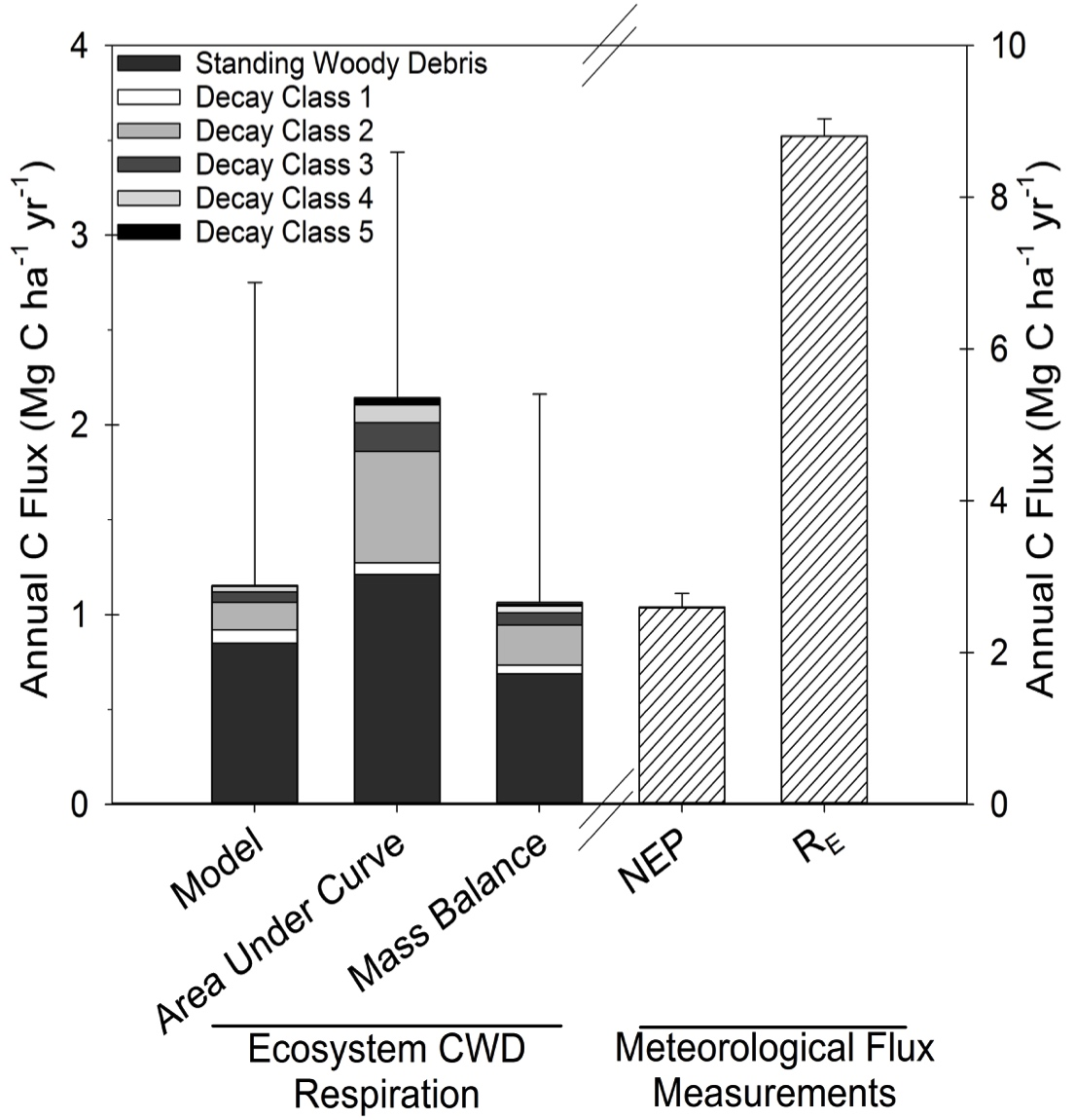
UMB/UMd: Schmid AV, Vogel CS, Liebman E, Curtis PS, Gough CM. 2016. Coarse woody debris and the carbon balance of a moderately disturbed forest. Forest Ecology and Management, 361: 38-45.
At the UMd Ameriflux Core Site, researchers investigated coarse woody debris (CWD) respiration following moderate forest disturbance.
Respiration from standing dead wood was substantial, with total (standing + downed) CWD respiration comparable in magnitude to NEP and at least 12.5 % of total ecosystem respiration (R_{E}).
Total R_{E} following moderate disturbance did not increase even though CWD respiration increased, suggesting an offsetting decline in respiration from other sources.
⬅ Three approaches were used to estimate CWD respiration. Higher decay class numbers indicate advanced decay.

