Slide 1
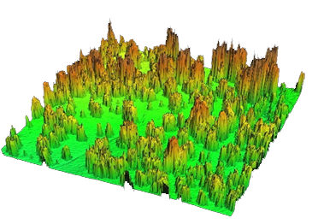
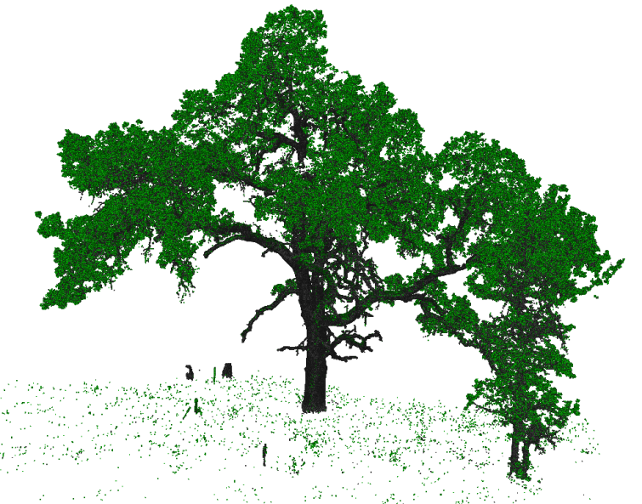
LiDAR at AmeriFlux Sites
Currently
Airborne LiDAR used more than terrestrial
Data not shared
Recommendations
Acquire a terrestrial LiDAR and hire personnel
Develop guidelines for acquiring, processing and sharing all types of LiDAR
Notes:
Pt1: questions it can help answer, interpreting fluxes locally, modeling ecosystem dynamics, upscaling fluxes to global scale using remote sensing
Pt2: Airborne provides less detail than terrestrial, but terrestrial demands more investments from the user. Certain science questions require fine scale descriptions of structure. Uncertainty is not well understood
Pt3: also proposed manipulation experiments, increasing demand for fast revisit intervals
Pt4: personnel dedicated to acquiring, processing and sharing data across all sites
LiDAR can describe canopy structure
Leaf distribution, biomass, spatial variability
New context of AmeriFlux
Enable sharing of resources between sites (human & instrumentation)

